Slide 1
Lecture 1-2
FUNDAMENTALS OF SOFTWARE ENGINEERING
Mehwish Mumtaz

Slide 2
Text Book
Roger Pressman, Software Engineering: A Practitioner’s Approach(Selected Chapters)
Shari Lawrence PFleeger and Joanne M. Atlee, Software Engineering Theory and Practice, Fourth Edition (Selected Chapters)
Ian Sommerville, Software Engineering (Selected Chapters)

Slide 3
Why is SE Needed?
Computers everywhere
Toaster, Microwave, Temperature control of A/C, Surgical Equipment…
Computers need to be managed
Software runs on all computers
Make lives comfortable, efficient, effective…
E.g Document system. Estamping PITB
SE practices ensure development of good software to improve our living standard

Slide 4
Why Do We Need to Study SE?
What could be the benefits?

Slide 5
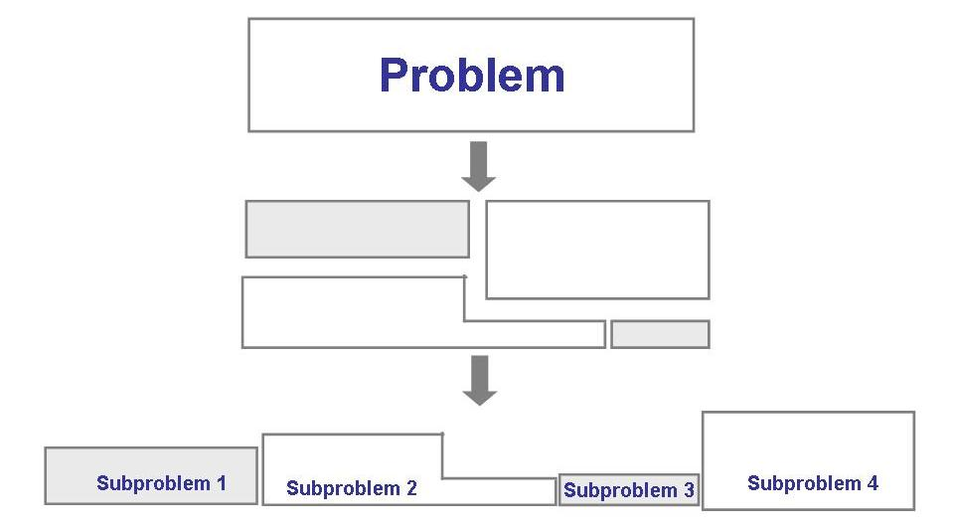
Solving Problems
Analysis

Slide 6
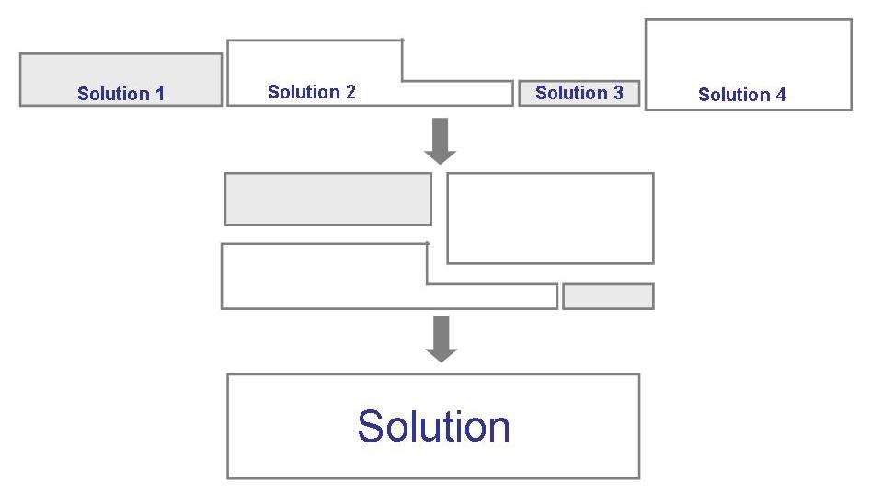
Solving Problems (continued)
Synthesis

Slide 7
Software Engineering
Solving Problems
Computers
Computing

Slide 8
Software?
Computer programs along with associated configuration data and documentation s.t. the programs are correctly operated
Configuration data helps set up the programs
System documentation helps understand structure of the system
User documentation explains how to use the system

Slide 9
Engineering?
Engineers’ Job?
Make things work
Apply theories, methodologies, tools appropriately
Provide solutions in absence of applicable theories and methods
Realize financial and organizational constraints

Slide 10
Aspects of Software Production?
Technical process of developing software
Activities such as management of project and teams
Development of tools, theories, methods to support production of software

Slide 11
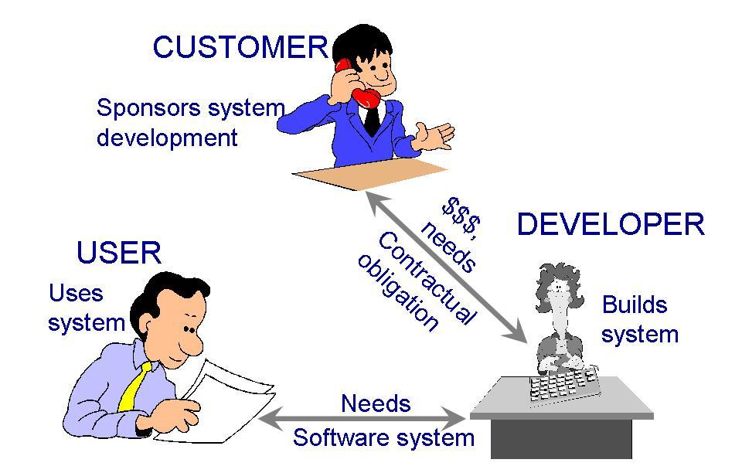
Who Does Software Engineering?
Participants (stakeholders) in a software development project

Slide 12
Challenges for Software Industry
 | 2012 | 2013 | 2014 | 2015 | 2016
Successful Projects | 27% | 31% | 28% | 29% | 32%
Challenged Projects | 56% | 50% | 55% | 52% | 49%
Failed Projects | 17% | 19% | 17% | 19% | 19%
Report for Year 2012 to 2016 (Standish 2016)
Factors Affecting Project Success Rate
Project Size and Complexity
Customer Satisfaction Level
Development and Budget Process
Skills of Developers and Managers
are

Slide 13
Development Team
Requirement analysts: work with the customers to identify and document the requirements
Designers: generate a system-level description of what the system is supposed to do
Programmers: write lines of code to implement the design
Testers: catch faults
Trainers: show users how to use the system
Maintenance team: fix faults that show up later
Librarians: prepare and store documents such as software requirements
Configuration management team: maintain correspondence among various artefacts

Slide 14
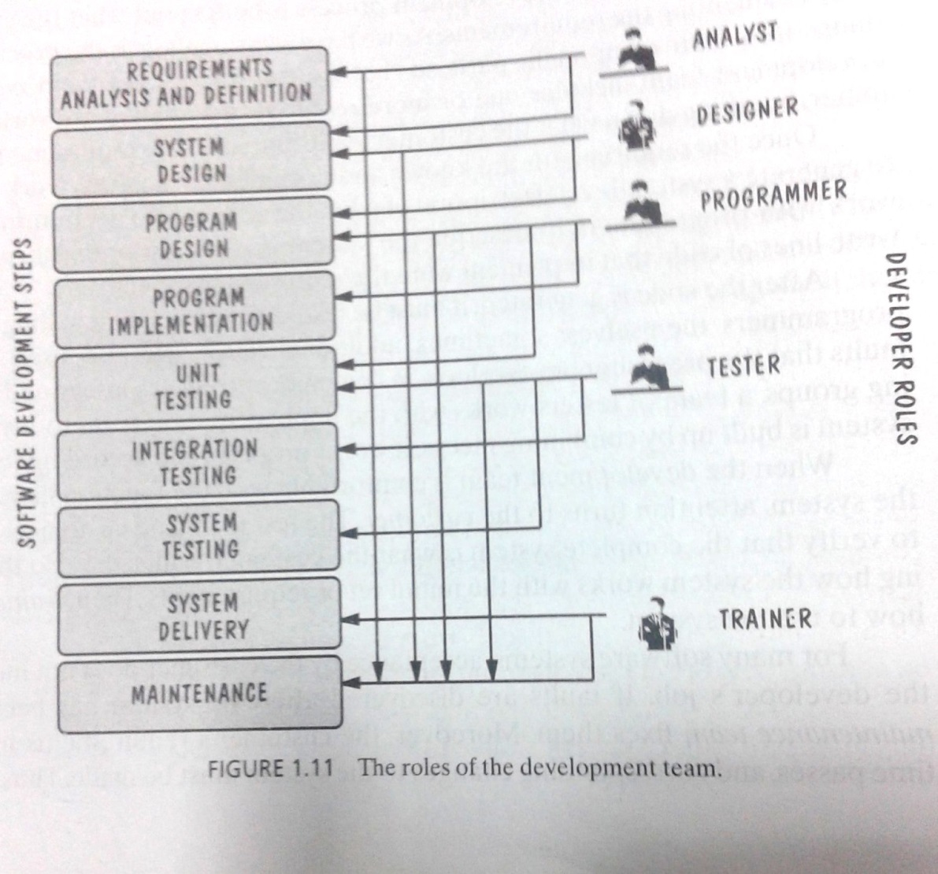
Development Team (Roles)
Who Does What?

Slide 15
Paradigm
(Models)
Resources
Software Engineering
Process
Skillset
Lifecycle
Requirements Analysis | Design | Coding | Testing | Deployment | Maintenance
Typical phases in lifecycle of software

Slide 16
Software Lifecycle
Phases
Requirements analysis and definition
System (architecture) design
Program (detailed/procedural) design
Writing programs (coding/implementation)
Testing: unit, integration, system
System delivery (deployment)
Maintenance

Slide 17
Software Engineers?
Adopt a systematic and organized approach, effectively, to produce high quality software
May have to use Ad hoc(Necessary) approaches to develop software
Some real complex problems may not be solved using elegant theories of CS

Slide 18
What is a Good Software Product?
Good software engineering must always include a strategy for producing quality software
Product Quality?
Multiple facets…

Slide 19
What is a Good Software Product?
Users judge external characteristics (e.g., correct functionality, number of failures, type of failures)
Designers and maintainers judge internal characteristics (e.g., ease of modification)
Thus different stakeholders may have different criteria
Need quality models

Slide 20
What is a Good Software Product? McCall's Quality Factors
Correctness
The extent to which a software meets its requirements specification.(Fulfill Customer Objective).
Functional Requirements: Directly specify e.g Mobile application
Non functional Requirements: Loading time of application, Performance of the application
Efficiency
The amount of hardware resources and code the software, needs to perform a function.
Integrity
The extent to which the software can control an unauthorized person from the accessing the data or software.
Reliability
The extent to which a software performs its intended functions without failure.(Not a serious error. Therac 25. We expect errors)
Usability
The extent of effort required to learn, operate and understand the functions of the software.

Slide 21
What is a Good Software Product? McCall's Quality Factors
6. Maintainability –
The effort required to detect and correct an error during maintenance phase. (Modification in Initial release, bug fixing phase, software evolution phase, old software and reverse engineering)
7. Flexibility The effort needed to improve an operational software program.
8. Testability – The effort required to verify a software to ensure that it meets the specified requirements.
9. Portability – The effort required to transfer a program from one platform to another.
10. Re-usability – The extent to which the program’s code can be reused in other applications. E.g Car
11. Interoperability – The effort required to integrate two systems with one another.

Slide 22
Lehman’s Laws of Software Evolution
(1974) "Continuing Change" — A system must be continually adapted or it becomes progressively less satisfactory. It happens so until it becomes economical to replace it by a new or a restructured version.-Add new features e.g Soneri Bank software
(1974) "Increasing Complexity/Entropy" —Complexity/entropy of a system increases with time, unless work is done to maintain or reduce it-lines of code
(1991) "Continuing Growth" — the functional content of a system must be continually increased to maintain user satisfaction over its lifetime
(1996) "Declining Quality" — the quality of a system will appear to be declining unless it is rigorously maintained and adapted to operational environment changes

Slide 23
Software Engineering
Disciplined, consistent, and systematic effort to construct (design + build) and maintain good quality software in timely and cost-effective manner

Slide 24
How Successful Have We Been
Perform tasks more quickly and effectively
Word processing, spreadsheets, e-mail
Support advances in medicine, agriculture, transportation, multimedia education, and most other industries
Many good stories
However, software is not without problems (recall the Standish report on challenged and failed projects???)

Slide 25
How Successful Have We Been
Malfunctioning in Therac-25 killed several people
Reliability constraints have caused cancellation of many safety critical systems
Safety-critical: something whose failure poses a threat to life or health

Slide 26
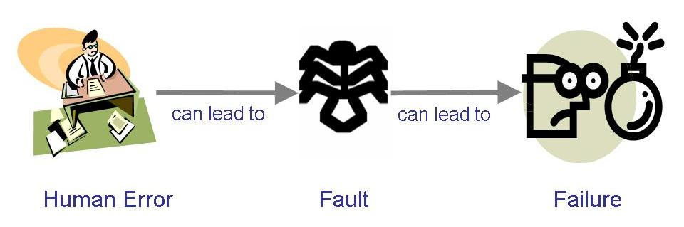
Terminology for Describing Bugs
A fault: occurs when a human makes a mistake, called an error, in performing some software activities
A failure: is a departure from the system’s required behaviour. A failure indicates that the system is not performing as required. Any type of failure in a system can open it up to fuzz testing. Fuss testing “is a quality assurance technique used to discover coding errors and security loopholes in software, operating systems or networks. It involves inputting massive amounts of random data, called fuzz, to the test subject in an attempt to make it crash.

Slide 27
Terminology for Describing Bugs
Defect:
If the actual result of the software deviates from the one expected and anticipated by the team of testers, while testing the software, then it results into a defect
Examples
An error in coding or logic that impacts the software and causes it to malfunction or perform in an inaccurate manner.
Any deviation from the customer requirements also leads to defects in the software.
Troubles and mistakes in the external behaviour and internal structure and design.
Providing wrong and inaccurate inputs.
Bugs
Bugs are the most integral part of a software system and can be termed as the errors, flaws, and faults present in the computer program that impact the performance as well as the functionality of the software can cause it to deliver incorrect and unexpected results. These not only impact the performance of the software, but also cause it to behave in an unanticipated way.
Reasons for Bugs:
From errors and mistakes made in the source code of the software, to issues and flaws found in the software design,
Error or flaw found in the development environment of the software.
Issue in the software or hardware that leads it to malfunction.
Discrepancies in the Operating System used by the program.
Few bugs are even caused due to incorrect codes produced by compilers.

Slide 28
An Engineering Approach
Idea to build a house
Asking someone to build the house
Explaining requirements
Getting designs
Modifying + Approving designs
Inspecting the construction
Adding new features
Testing household components
Moving in
Getting issues fixed after moving in
Building a House

Slide 29
An Engineering Approach
Requirement analysis and definition
System design
Program design
Writing the programs
Unit testing
Integration testing
System testing
System delivery
Maintenance
Building a System

Slide 30
Information Systems-Quality

Slide 31
Real Time Example
Factory system respond to a high temperature.
Mouse clicking

Slide 32
Software Engineering Principles Successful Software Development
Some principles are:
Rigor and Formality
Software Development -Creative Activity
Rigor Approach produce desirable products
Applied methods and techniques and then find the results
Not always to be formal methods-past experience but if not experience then use mathematical model
Precision and exactness
Assessment of engineering activity and the results.
Example

Slide 33
Software Engineering Principles Successful Software Development
Separation of Concerns
Dealing with the problem
Correctness and efficiency
Parts of system

Slide 34
Software Engineering Principles Successful Software Development
Modularity

Slide 35
Software Engineering Principles Successful Software Development
Anticipation of Change

Slide 36
A Systems Approach
Hardware/Software
People
Interactions

Slide 37
A Systems Approach (Contd.)
Objects
i.e. things
Activities
Actions taken
Input / Outputs
Relationships for example:
Which object performs what activities
Which objects are associated with other objects
System Boundary
Who generates input and who receives output
Which objects/activities are part of the system and which are not
Nested systems, related systems, interrelated systems

Slide 38
References
Shari Lawrence PFleeger and Joanne M. Atlee, Software Engineering Theory and Practice, Fourth Edition
Roger Pressman, Software Engineering: A Practitioner’s Approach
Ghezzi et al., Fundamentals of Software Engineering
Book slides from UCF
Acknowledgement
A few slides have been reused from UCF slides for the SE course

